Slide 1


Actisens Cloud UI
Requirements
www.stellapps.com
Disclaimer:
This presentation is intended to be used only by the officials, authorized representatives and employees of Stellapps Technologies Private Limited (“Stellapps”). No copy or content(s) of this presentation shall be used, copied, reproduced, captured or imitated except with the prior permission of Stellapps. Stellapps retains all interests and rights including intellectual and proprietary interests which are or may be associated with this presentation, whether at present or in future. Stellapps makes no claims, promise or guarantee of any kind about the accuracy, completeness or adequacy of the content of this presentation and expressly disclaims any liability for errors and omission in such content, whether used with or without its permission.

Slide 2
[Generic] [ActiSens Portal] List of Gateway( L3) - user story
User | Support User
User Story | The user wants to see the details of L3 (Gateway) associated with Actisens.
Acceptance criteria | The user should be able to navigate to Gateways and see List of Gateways The user should be able to see the list of all L3s related to actisens as given in next slide. There should be a toggle switch to view only ‘Is deployed’ gateways. The user should be able to click on any L3 and should be navigated to L3 details page which have more details about the L3. There should be a provision to filter based on various attributes ( mentioned in the next slide) Graph showing Date in X axis and Live or Not Live in Y axis should be present. Live status should be highlighted with green color and Not Live should be highlighted with red color. The report format and column definitions are given in the next slide. The report should be downloadable in CSV, Excel and PDF formats.

Slide 3
List of Gateway - Sample Format
List of attributes in the List | Gateway ID | Farm Name | FW version | Gateway status | Gateway communication status | Count of L1s connected in last 12 hrs | Signal strength | Battery Voltage | Uptime
Options available |  |  |  | -In Inventory, -In Cluster, -Available with FE as spare, -Deployed in Field, -For Service, -Discarded. | -Live -Not Live/ Awaiting Data
How the value is populated |  | Associated Farm (makes sense only to ‘Deployed in field’) On clicking should direct to Farm page | Auto Populated Updated every 12 hrs | Populated from device repository or manual entry- TBD | Auto Populated based on Logic | Auto Populated (dc - number of devices connected) Updated every 12 hrs (di- uuid list) | Auto Populated Updated every 12 hours | Auto populated Updated every 12 hrs - Should get the list of L1 Sl no on clicking this | Auto populated Updated every 12 hrs
Filters - Gateway Status, Gateway Communication Status,Signal Strength, Uptime, Battery Voltage [ All less than/ Greater than]

Slide 4
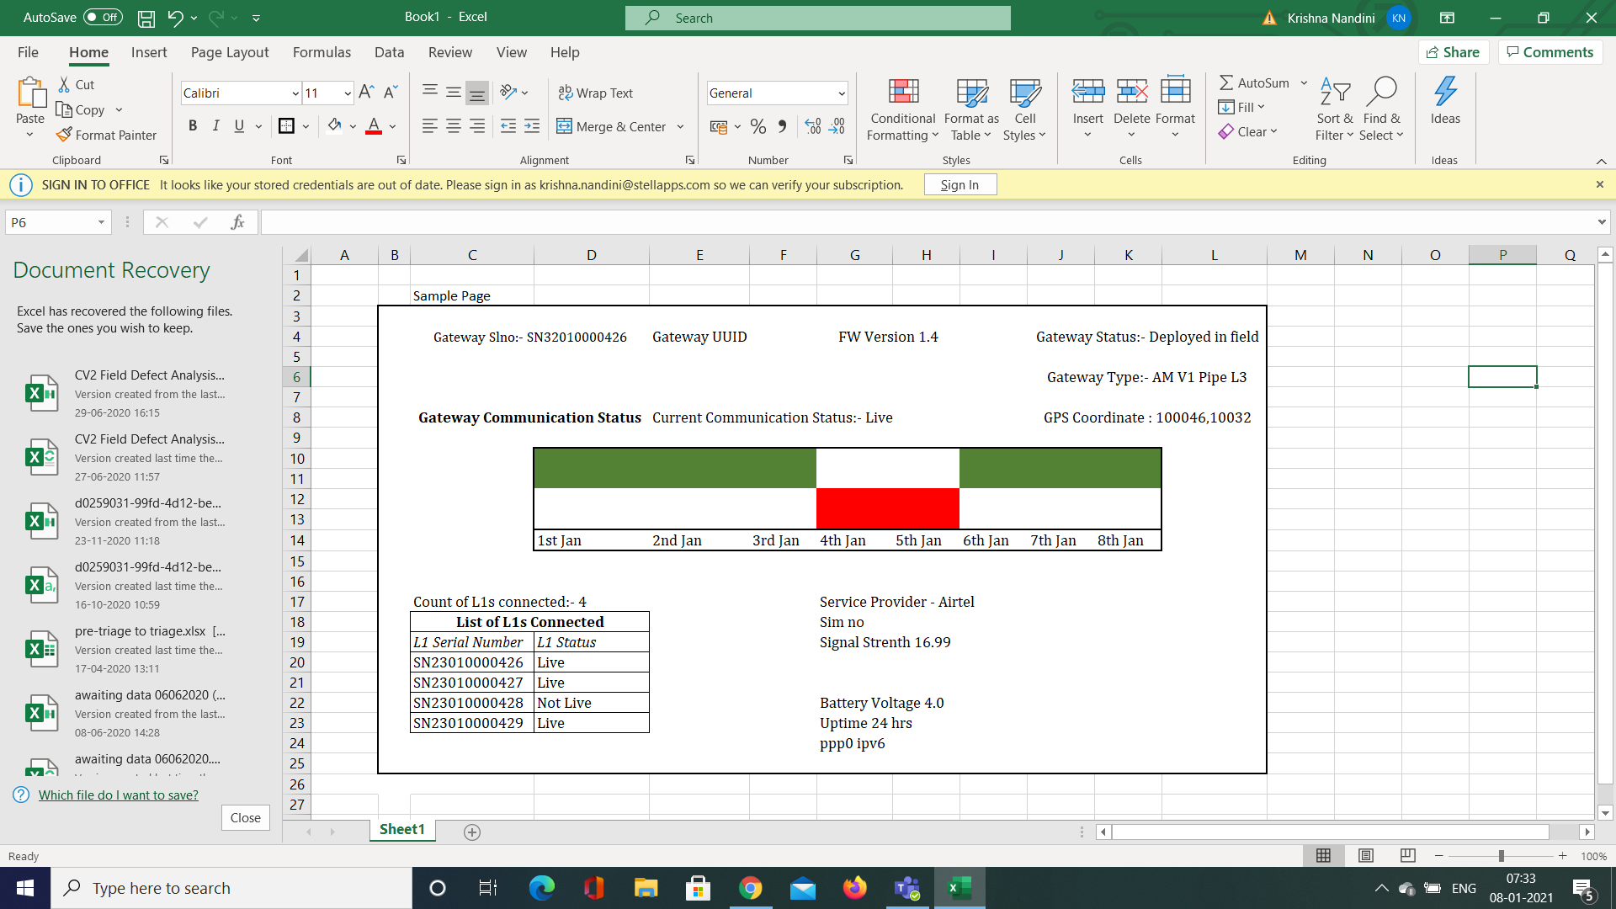
On clicking L3 serial number from the list user should navigate to this page

Slide 5
Additional List of attributes present only in particular L3 Details page - How that is populated
Gateway UUID | GPS Coordinate | List of L1s connected in last 12 hrs | Service provider | Sim no | Gateway Type | PPPo ipv6
Auto generated based on conversion logic | Auto Populated Updated every 12 hrs | Auto populated Di- uuid list | Auto Populated Updated every 12 hrs | Auto Populated Updated every 12 hrs | Auto-populated from Gateway -farm association page/ device repository -AM - L3 - V1 Pipe -AM - Mobile L3 -AM 4G L3 V1 Box | Auto Populated Updated every 12 hrs
Graph with Day wise L3 Live or Not Live Status
Use:- From Support/ Field perspective :- Good visual representation to understand the status of device.
By default should be present for past 7 days.
User should be able to give a range of date as well.

Slide 6
2. [Generic] [ActiSens Portal] List of Activity meters (L1) - user story
User | Support User
User Story | The user wants to see the details of L1 (Activity meter) associated with Actisen.
Acceptance criteria | The user should be able to navigate to Activity meter and see List of Activity meter The user should be able to List of all L1s related to actisens as given in next slide. There should be a toggle switch to view only ‘Is deployed’ actisens. The user should be able to click on any L1 and should be navigated to L1 details page which have more details about the L1. There should be a provision to filter based on various attributes ( mentioned in next slide) Graph showing Date in X axis and Live or Not Live in Y axis should be present. The report format and column definitions are given in the next slide. The report should be downloadable in CSV, Excel and PDF formats.

Slide 7
List of Activity meter - Sample Format
List of attributes in the List | Activity meter SLno | Gateway SLno | Farm Name | FW version | Activity meter status | AM communication status | Window time | Orientation status | Battery Voltage | LED Blink status
Options available |  |  |  |  | -In Inventory, -In Cluster, -Available with FE as spare, -Deployed in Field, -For Service, -Discarded. | -Live -Not Live/ Awaiting Data |  | -Normal- -Abnormal |  | Blinking Not Blinking
How the value is populated |  |  | Associated Farm (makes sense only to ‘Deployed in field’) On clicking should direct to Farm page | Auto Populated Updated every 12 hrs | Populated or manual entry- TBD | Auto Populated based on Logic [Discussed incoming slides] |  | Auto populated based on logic [Discussed incoming slides] | Auto populated based on Last packet data | By default all should be blinking. Update to Not Blinking based on FE’s input
Filters - Activity Meter Status, Activity Meter Communication Status,LED Blink status, Battery Voltage

Slide 8
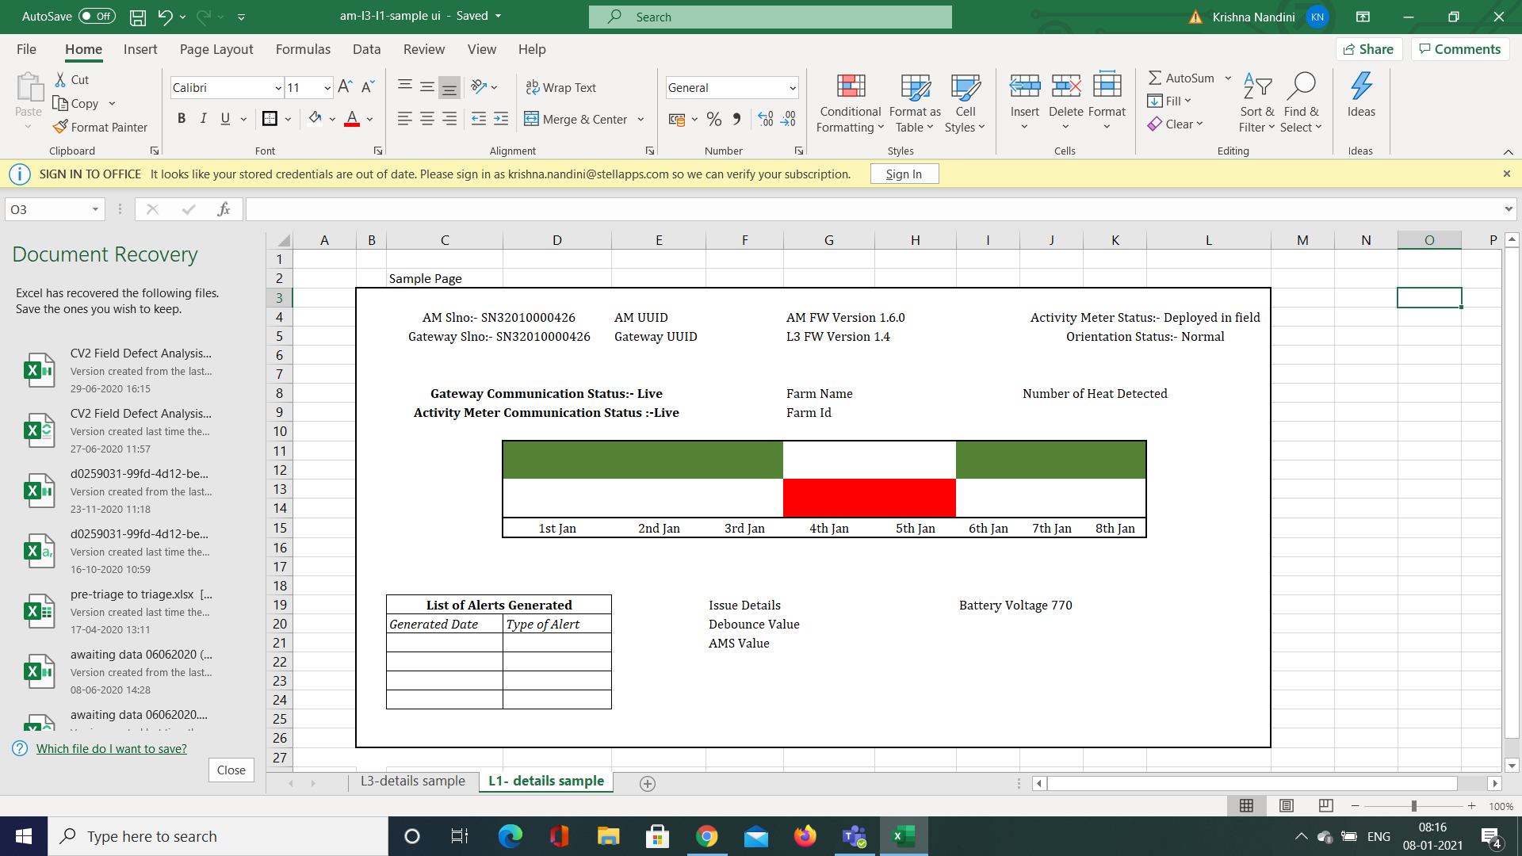
On clicking L1 serial number/ row from the list user should navigate to this page

Slide 9
Additional List of attributes present only in particular L1 Details page - How that is populated
AM UUID | Gateway UUID | Gateway FW Version | Gateway Communication Status | Farm Id | Number of Heat detected | List of Alerts generated | pppo ipv6
Auto generated based on conversion logic | Auto generated based on conversion logic | Auto Populated Updated every 12 hrs | Live/ Not live. Auto populated based on logic. | Auto Populated Updated every 12 hrs | Auto Populated Updated every 12 hrs | Heat Alerts Service Alerts | Auto Populated Updated every 12 hrs
Graph with Day wise L3 Live or Not Live Status
Use:- From Support/ Field perspective :- Good visual representation to understand the status of device.
By default should be present for past 7 days.
User should be able to give a range of date as well.

Slide 10
3. [Generic] [ActiSens Portal] Live status report for Activity meter (L1) - Flow
START
STOP
Support team checks the Live or not Live status of activity meter
Support team checks the Live or not Live status of other activity meters in gateway
Field team needs to check the interrupt LED blink
Support team to check the status after the calculated recovery date
Not Live
Live
Blinks
Not
Live
Not live
Live
Not Blinking
STOP
L3 Troubleshooting
Field team to visit the farm and replace the activity meter with the spare and the send the faulty device to service team

Slide 11
3. [Generic] [ActiSens Portal] Live status Report for Activity Meter (L1)
User | Support User
User Story | The user wants to see the list of actitrak devices with their live or not live status, with the associated details.
Remarks | Live or Not Live Logic:- If no data is received from L1 for past 24 *3 hours, it should be Not Live/ Awaiting data status.
Acceptance criteria | The user should be able to click on the live status in dashboard to redirect to live status report Additionally, the user should be able to navigate using the path: reports -> Live status report for L1 The columns in the report is mentioned in the next slide There should be filters & sort options on top of every column The user should able to download the report same as in the portal UI ( with the applied filters and sorting) in csv, excel and pdf formats.

Slide 12
[Generic] [ActiSens Portal] Live status report for L1
Live or Not Live Logic:- If no data is received from L1 for past 24 *3 hours, it should be Not Live/ Awaiting data status.
Activity meter ID | Gateway ID | Farm Name | Cattle id | AM (L1) communication status | Gateway (L3) communication status | Deployed Date | Last packet received Date | No of days in Not Live status
No of Live Activity meter and No of Not Live Activity meter should be displayed on top of the report.
Additional fields that can be included in next stage.
Field Visit date
LED Blinking status
Approx recovery date
Recovered date
Notes:
Field Visit date
LED Blinking status
Approx recovery date
Recovered date

Slide 13
4. [Generic] [ActiSens Portal] Live status Report for Gateway (L3)
User | Support User
User Story | The user wants to see the list of L3 devices with their live or not live status, with the associated details.
Remarks | Live or Not Live Logic:- If no data is received from L1 for past 24 hours, it should be Not Live/ Awaiting data status.
Acceptance criteria | The user should be able to click on the live status in dashboard to redirect to live status report Additionally, the user should be able to navigate using the path: reports -> Live status report for L3 The columns in the report is mentioned in the next slide There should be filters & sort options on top of every column The user should able to download the report same as in the portal UI ( with the applied filters and sorting) in csv, excel and pdf formats.

Slide 14
4. [Generic] [ActiSens Portal] Live status report for Gateway (L3)
Live or Not Live Logic:- If no data is received from L3 for past 24 hours, it should be Not Live/ Awaiting data status.
Gateway ID | Farm Name | Gateway (L3) communication status | Deployed Date | Last data received Date | No of days in Not Live status | Ppp0 ipv6
No of Live Gateway and No of Not Live Gateway should be displayed on top of the report.
Notes:
Field Visit date
LED Blinking status
Approx recovery date
Recovered date

Slide 15
5. [Generic] [ActiSens Portal] Abnormal Orientation - Flow
START
Support team checks the aborient values for last continuous 6 packets
Resolved
Aborient = 135
Aborient = 132
Support team informs field team to check the orientation of the device
Field Team informs support team after correction
Field Team corrects the orientation by visiting the farm

Slide 16
5. [Generic] [ActiSens Portal] Abnormal Orientation report - user story
User | Support User
User Story | The user wants to see the list of actisens devices with abnormal orientation for a selected period of time. The user wants to see the current status and resolved time for all the abnormal orientation occurrences.
Acceptance criteria | The user should be able to navigate to reports -> troubleshooting -> abnormal orientation to view the list of devices with abnormal orientation in last 24 hrs ( by default) There should be a provision to select ‘from date & time’ and ‘To date and time’ so that list of all abnormal orientation occurrences can be downloaded. All the devices that observed aborient value as 132 for last 6 continuous packets in the selected time range should be present in the list in the order of first abnormal orientation occurrence. The report format and column definitions are given in the next slide. The report should be downloadable in CSV, Excel and PDF formats.
Feature Type
Priority

Slide 17
5. [Generic] [ActiSens Portal] Abnormal Orientation Report
Device Serial no | Cattle ID | Farm name | Gateway sl.No | Date & Time of first occurrence | Last packet Date & Time | Orientation status | Resolved time
Device serial No - L1 Serial No
Cattle ID, Farm Name, Gateway SL.NO - to represent associated cattle, farm and gateway
Date & Time of first occurrence - The device level timestamp of first packet with aborient = 132 in the format DD/MM/YYYY HH:MM ( Converted to IST)
Last packet Date & Time - The device level timestamp of last received packet in the format DD/MM/YYYY HH:MM (Converted in IST)
Orientation Status - “Normal”, if aborient = 135 for continuous 6 packets, “abnormal”, if aborient = 132 for continuous 6 packets
Resolved Time - Timestamp of first packet with aborient = 135, after continuous packets of aborient = 132

Slide 18
6. [Generic] [ActiSens Portal] Zero AMS values - Flow
START
Support team checks the AMS values ( Step count, standing time, moving time) for last continuous 10 packets
Resolved
Any of the values = Non zero
All Zeo
Support team does the OTA reboot
Any of the values = Non zero
Support team checks the AMS values ( Step count, standing time, moving time) for last continuous 10 packets
Support team checks the AMS values ( Step count, standing time, moving time) for last continuous 10 packets
Field Team does checks at field level ( removed or not, LED blink test)
All Zeo
Any of the values = Non zero
Resolved

Slide 19
6. [Generic] [ActiSens Portal] Zero AMS values
User | Support user
User Story | The user wants to see the list of actisens devices with zero AMS values for a selected period of time The user wants to see the current status and resolved time for all the listed devices.
Remark | Devices with zero AMS values = all of Step count, standing time, moving time are zero for last continuous 10 packets
Acceptance criteria | The user should be able to navigate to reports -> troubleshooting -> Zero AMS to view the list of devices with zero AMS values for last 24 hrs ( by default) There should be a provision to select ‘from date & time’ and ‘To date and time’ so that list of zero AMS value devices can be downloaded. All the devices that observed zero AMS values for last 10 continuous packets in the selected time range should be present in the list in the order of first Zero AMS value occurrence. The report format and column definitions are given in the next slide. The report should be downloadable in CSV, Excel and PDF formats.
Feature Type
Priority

Slide 20
6. [Generic] [ActiSens Portal] Zero AMS values
Device Serial no | Cattle ID | Farm name | Gateway sl.No | Date & Time of first occurrence | Last packet Date & Time | AMS value Status | Resolved time
Device serial No - L1 Serial No
Cattle ID, Farm Name, Gateway SL.NO - to represent associated cattle, farm and gateway
Date & Time of first occurrence - The device level timestamp of first packet with AMS values = zero among the continuous packets with zero AMS values in the format DD/MM/YYYY HH:MM ( Converted to IST)
Last packet Date & Time - The device level timestamp of last received packet in the format DD/MM/YYYY HH:MM (Converted in IST)
AMS value Status - “Zero”, if AMS values = 0 for last continuous 10 packets, “Non Zerol”, if any of the AMS values = non-zero for continuous 10 packets
Resolved Time - Timestamp of first packet non zero AMS value, after continuous packets of zero AMS values

Slide 21
7. [Generic] [ActiSens Portal] Debounce value report
User | Support user
User Story | The user wants to filter the actisens devices using debounce values. The user should be further able to see the packet details of the selected device from the list.
Remark | Debounce value indicates different meanings to internal teams( Provided in the next slide)
Acceptance criteria | The user should be able to navigate to reports -> troubleshooting -> Debounce value to see the list of devices with a debounce value filter. There should be a provision to filter the devices using debounce value filter There should be a provision to select ‘from date & time’ and ‘To date and time’ so that list of devices with filter applied for selected time range will appear. When the user enter the debounce value in the filter field, all the devices with debounce value equal to the entered debounce value for at least one packet in the selected time range should be present in the list. Once the user clicks the device serial number in the filtered list, it should be redirected to the packet details of the selected device, in which debounce value can be filtered again. The report format and column definitions are given in the next slide. The report should be downloadable in CSV, Excel and PDF formats.
Feature Type
Priority

Slide 22
7. [Generic] [ActiSens Portal] Debounce value report
From
To
Debounce Value
Device Serial no | Cattle ID | Farm name | Gateway sl.No | Date ( DD/MM/YYYY) | No of packets (with debounce value =x)
Device serial No - L1 Serial No
Cattle ID, Farm Name, Gateway SL.NO - to represent associated cattle, farm and gateway
Date - Each date in the selected date range should have separate rows in the report in the format DD/MM/YYYY
No of packets - This should provide the number of packets in the date mentioned with the entered debounce value

Slide 23
7. [Generic] [ActiSens Portal] Debounce value report - Packet details
From
To
Debounce Value
Packet Number | Date | Device Time stamp ( IST) | Gateway time | Cloud Time | Debounce Value

Slide 24
[Generic] [ActiSens Portal] Debounce value report - Debounce values
1 - Writing to accelerometer failed , usually not observed
2 - Writing failed while reading to accelerometer failed , usually not observed
4-Reading failed while reading from accelerometer failed
8- Invoking read failed after accelerometer interrupt received
16 - Resetting the accelerometer hardware from software failed
32 - Initial configuration of accelerometer hardware failed
64 - Analysis of registers read on initialization failed
128 - Analysis of registers read on initialization failed
256- Accelerometer stack driver failed upon read call
512 -Accelerometer stack driver failed upon write call
1024 - Accelerometer stack driver failed upon write call
2048 - Failed to enable the transient interrupt
4096 - Failed to disable the transient interrupt
8192 - Sitting time calculation failed due to RTC issue
16384 - Rtc internal alarm set failed
32768 - Device alarm failed to set after retry internal reboot is added to avoid device hung.

Slide 25
8. [Generic] [ActiSens Portal] Battery Analysis
User | Support user
User Story | The user wants to see the list of devices with following battery abnormalities Low voltage - Voltage < 600 ADC value Fast Drain Voltage fluctuations
Acceptance criteria | The user should be able to navigate to reports -> troubleshooting -> Battery analysis reports The user should be able to select the report type in the battery analysis report. The report type drop downs should be low voltage report, fast drain report and voltage fluctuation report There should be a provision to select ‘from date & time’ and ‘To date and time’. In the low voltage report, the user should be able to the list of devices with battery voltage less than 600 ADC Value, by default. The user should be able to chanage the filter value if required. Once the user clicks the device serial number in the filtered list, it should be redirected to the packet details of the selected device, in which battery voltage for each packet is available and can be filtered. The report format and column definitions are given in the next slide. The report should be downloadable in CSV, Excel and PDF formats.

Slide 26
[Generic] [ActiSens Portal] Battery Analysis reports - Low voltage report
From
To
Battery Voltage <
600
Device Serial no | Cattle ID | Farm name | Gateway sl.No | Battery voltage | Date and Time of first occurrence
Device serial No - L1 Serial No
Cattle ID, Farm Name, Gateway SL.NO - to represent associated cattle, farm and gateway
Battery Voltage - Voltage of battery in last packet
Date and time of first occurrence - The date in which the battery voltage < 600 ADC for first time

Slide 27
THANK YOU
www.stellapps.com
Disclaimer:
This presentation is intended to be used only by the officials, authorized representatives and employees of Stellapps Technologies Private Limited (“Stellapps”). No copy or content(s) of this presentation shall be used, copied, reproduced, captured or imitated except with the prior permission of Stellapps. Stellapps retains all interests and rights including intellectual and proprietary interests which are or may be associated with this presentation, whether at present or in future. Stellapps makes no claims, promise or guarantee of any kind about the accuracy, completeness or adequacy of the content of this presentation and expressly disclaims any liability for errors and omission in such content, whether used with or without its permission.

